Slide 1


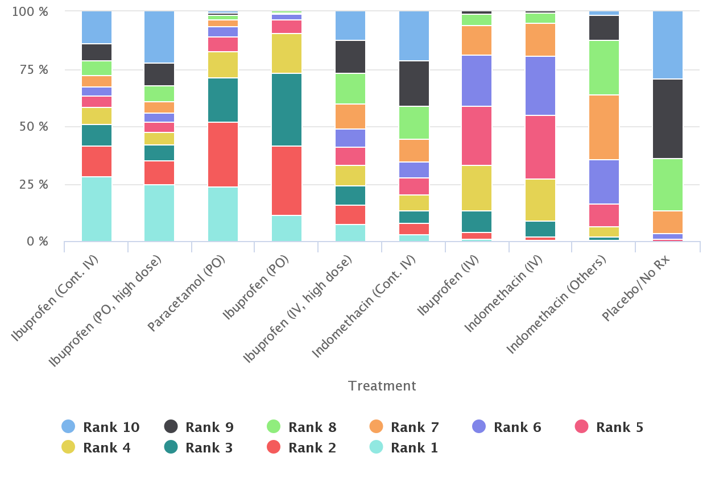
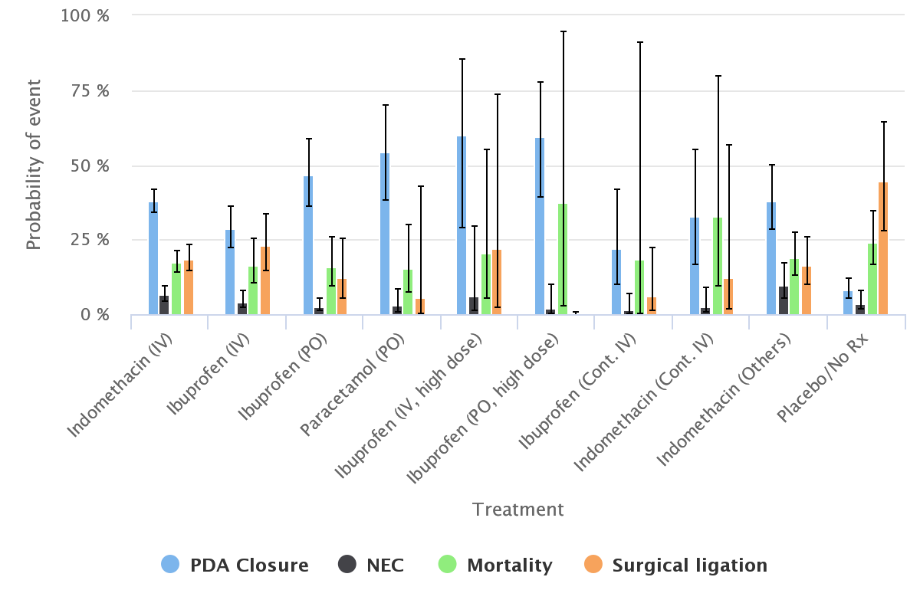
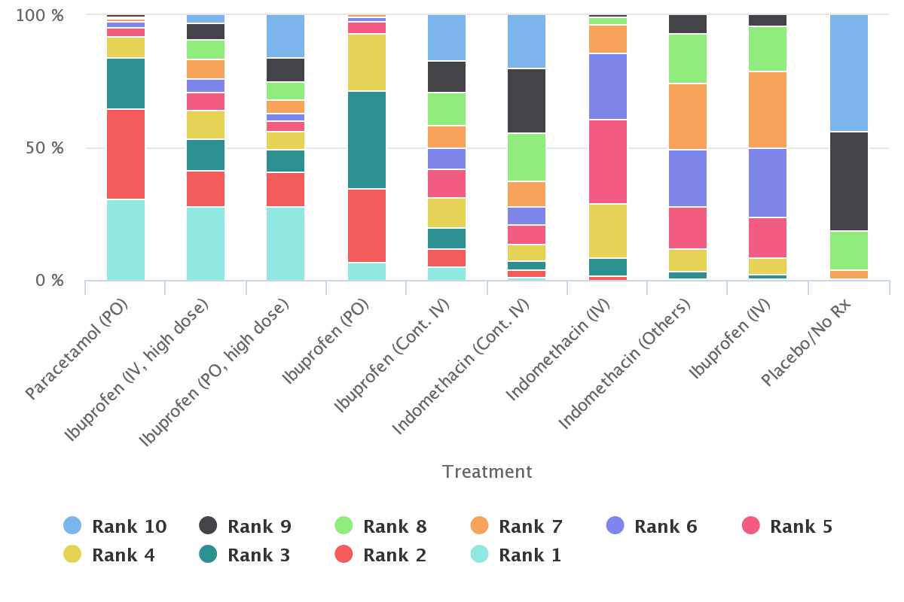


Variations in Practice May be Evidence-Based: Application of Multi-Criteria Decision Analysis to Treatments for Patent Ductus Arteriosus
Disher, Tim¹., Mitra, Souvik^{3,4}., Beaubien, Louis⁵., Campbell-Yeo, Marsha^{1,3,4}.
1. School of Nursing, Dalhousie University; 2. Cornerstone Research; 3. Department of Pediatrics, IWK Health Centre; 4. Faculty of Medicine, Dalhousie University; 5. Faculty of Management, Dalhousie University
Try our app!
tinyurl.com/cnprm-mcda
Background
Patent Ductus Arteriosus (PDA) is a common cardiovascular condition in preterm infants where considerable variation in management practices exists.
In a recent network meta-analysis of treatments for hemodynamically significant PDA (hsPDA), authors identified ten treatments evaluated across eight outcomes¹.
The study purpose was to evaluate how treatment decisions for hsPDA differ across decision maker preference sets and baseline event rates.
Results
Clinicians differed in outcome rankings (Table 1), which influenced treatment recommendations and their uncertainty (SM: highest FRA = continuous IV ibuprofen (0.28), CF = 0.33; TD: highest FRA = oral paracetamol (0.31), CF = 0.32). Central weights for the preference free model suggest that continuous IV ibuprofen is preferred when PDA closure is ranked low compared to mortality/NEC. Central weights for paracetamol are more balanced across all outcomes. Variations in baseline rates have a similar effect on recommendations.
Table 1. outcome characteristics and clinician ranking
Outcome name | Number of studies (N) | Clinician one ranking | Clinician two ranking
Mortality | 46 (3329) | 1 | 1
Necrotizing enterocolitis | 45 (3371) | 2 | 3
Surgical closure | 37 (2729) | 3 | 4
PDA closure | 60 (4256) | 4 | 2
PDA closure: Closure within one week of first dose; Mortality: Death at postmenstrual age of 36 weeks or before discharge; Necrotizing enterocolitis: Bell stage two or greater
DATA SOURCES
Eligible trials included randomized clinical trials that enrolled preterm or low birth weight (<2500g) infants.
The review included three primary outcomes and 11 secondary outcomes of which five had sufficient data for quantitative synthesis. For the purpose of this paper we focus on outcomes that had sufficient data to produce reasonable results and that were reported across all treatments:
PDA closure
Need for surgical ligation
Necrotizing enterocolitis
Neonatal mortality
Intraventricular hemorrhage was excluded since most cases would be expected to occur prior to initiation of treatment².
Methods
We conducted a re-analysis of a recently published Bayesian network meta-analysis of pharmacological treatments for hsPDA
We used Stochastic Multi-criteria Acceptability Analysis (SMAA)³ to identify optimal decisions given a set of outcome preferences. To simplify preference elicitation, we used ordinal preference constraints (e.g. Mortality is more important for decision making than necrotizing enterocolitis) from clinicians (SM, TD) and a “preference free” model. Sensitivity to baseline rates was explored through two scenarios which manipulated rates of NEC and mortality.
Monte-carlo methods were used to estimate parameters and their uncertainty with 30,000 iterations used for both.
Outcomes included first rank acceptability (FRA), the vector of central weights required to have an a priori preference for one treatment over another, and a confidence factor (CF) reflecting certainty in decisions.
Figure 2. Absolute probabilities of events. Based on the odds ratios estimated from the NMA and the average response rate in IV indomethacin. SMAA-MCDA views high probability of PDA closure and low probability of all other outcomes as good. Considerable uncertainty in estimates undermine confidence in results.
Figure 2. Smaa rankograms. Results of SMAA-MCDA under preferences for clinician one and clinician two. Decisions are primarily informed by first rank acceptability, although the spread of ranks is an important indicator of confidence. For example, high dose oral ibuprofen has high first rank acceptability but it also has high probability of being ranked in the worst positions.
Table 2. Results under the preference free model
Treatment | Confidence factor | Central weights
 |  | PDA Closure | Necrotizing enterocolitis | Mortality | Surgical ligation
Indomethacin (IV) | 0.5 % | 0.12 | 0.12 | 0.64 | 0.12
Ibuprofen (IV) | 1.18 % | 0.03 | 0.19 | 0.66 | 0.12
Ibuprofen (PO) | 8.7 % | 0.16 | 0.30 | 0.36 | 0.18
Paracetamol (PO) | 33.6 % | 0.24 | 0.24 | 0.28 | 0.24
Ibuprofen (IV, high dose) | 27.4 % | 0.38 | 0.21 | 0.25 | 0.17
Ibuprofen (PO, high dose) | 48.6 % | 0.25 | 0.26 | 0.19 | 0.30
Ibuprofen (Cont. IV) | 23.7 % | 0.07 | 0.30 | 0.38 | 0.24
Indomethacin (Cont. IV) | 1.49 % | 0.16 | 0.30 | 0.30 | 0.25
Indomethacin (Others) | 0.15 % | 0.23 | 0.06 | 0.55 | 0.16
Placebo/No Rx | 0 % | N/A | N/A | N/A | N/A
Central weights can be interpreted as the preferences required to have an a priori preference for one treatment. Confidence factor is the probability of a treatment being ranked first when weights are held at a treatment’s central weights.
limitations
This analysis inherits limitations from the evidence synthesis on which it is based. Specifically, the structure of the network leads to untrustworthy estimates of absolute probabilities.
REFERENCES
Mitra S, Florez ID, Tamayo ME, et al. Association of placebo, indomethacin, ibuprofen, and acetaminophen with closure of hemodynamically significant patent ductus arteriosus in preterm infants a systematic review and meta-analysis. JAMA - J Am Med Assoc. 2018;319(12):1221-1238. doi:10.1001/jama.2018.1896
Enzmann D, Murphy-Irwin K, Stevenson D, Ariagno R, Barton J, Sunshine P. The natural history of subependymal germinal matrix hemorrhage. Am J Perinatol. 1985;2(2):123-33
Van Valkenhoef G, Tervonen T, Zhao J, De Brock B, Hillege HL, Postmus D. Multicriteria benefit-risk assessment using network meta-analysis. J Clin Epidemiol. 2012;65(4):394-403. doi:10.1016/j.jclinepi.2011.09.005
Conclusions
These findings suggest that observed treatment variation may be the result of a rational synthesis of available evidence, local event rates, and outcome preference. Choosing between top treatments likely requires further head to head research.

